Slide 1

CMP3010 - Embedded Systems Programming
Lab Term Project
Topic:
Bluetooth Controlled Robot
Ugur Taysi (2101101)
Atif Ghani (2019751)

Slide 2
Project Description & Task Distribution
Project Description: Chosen topic was “Bluetooth Controlled Robot”. We chose to build an RC car using Bluetooth.
Task Distribution
Task / Person | Uğur Tayşi | Atif Ghani
Planning which components are needed |  | X
Planning initial circuit design | X
Buying components & gear | X | X
Bargaining at Yazıcıoğlu Electronics Center. 😎 | X
Assembling the robot | X | X
Programming | X | X
Circuit modeling | X
Producing report |  | X
Producing presentation slides |  | X

Slide 3
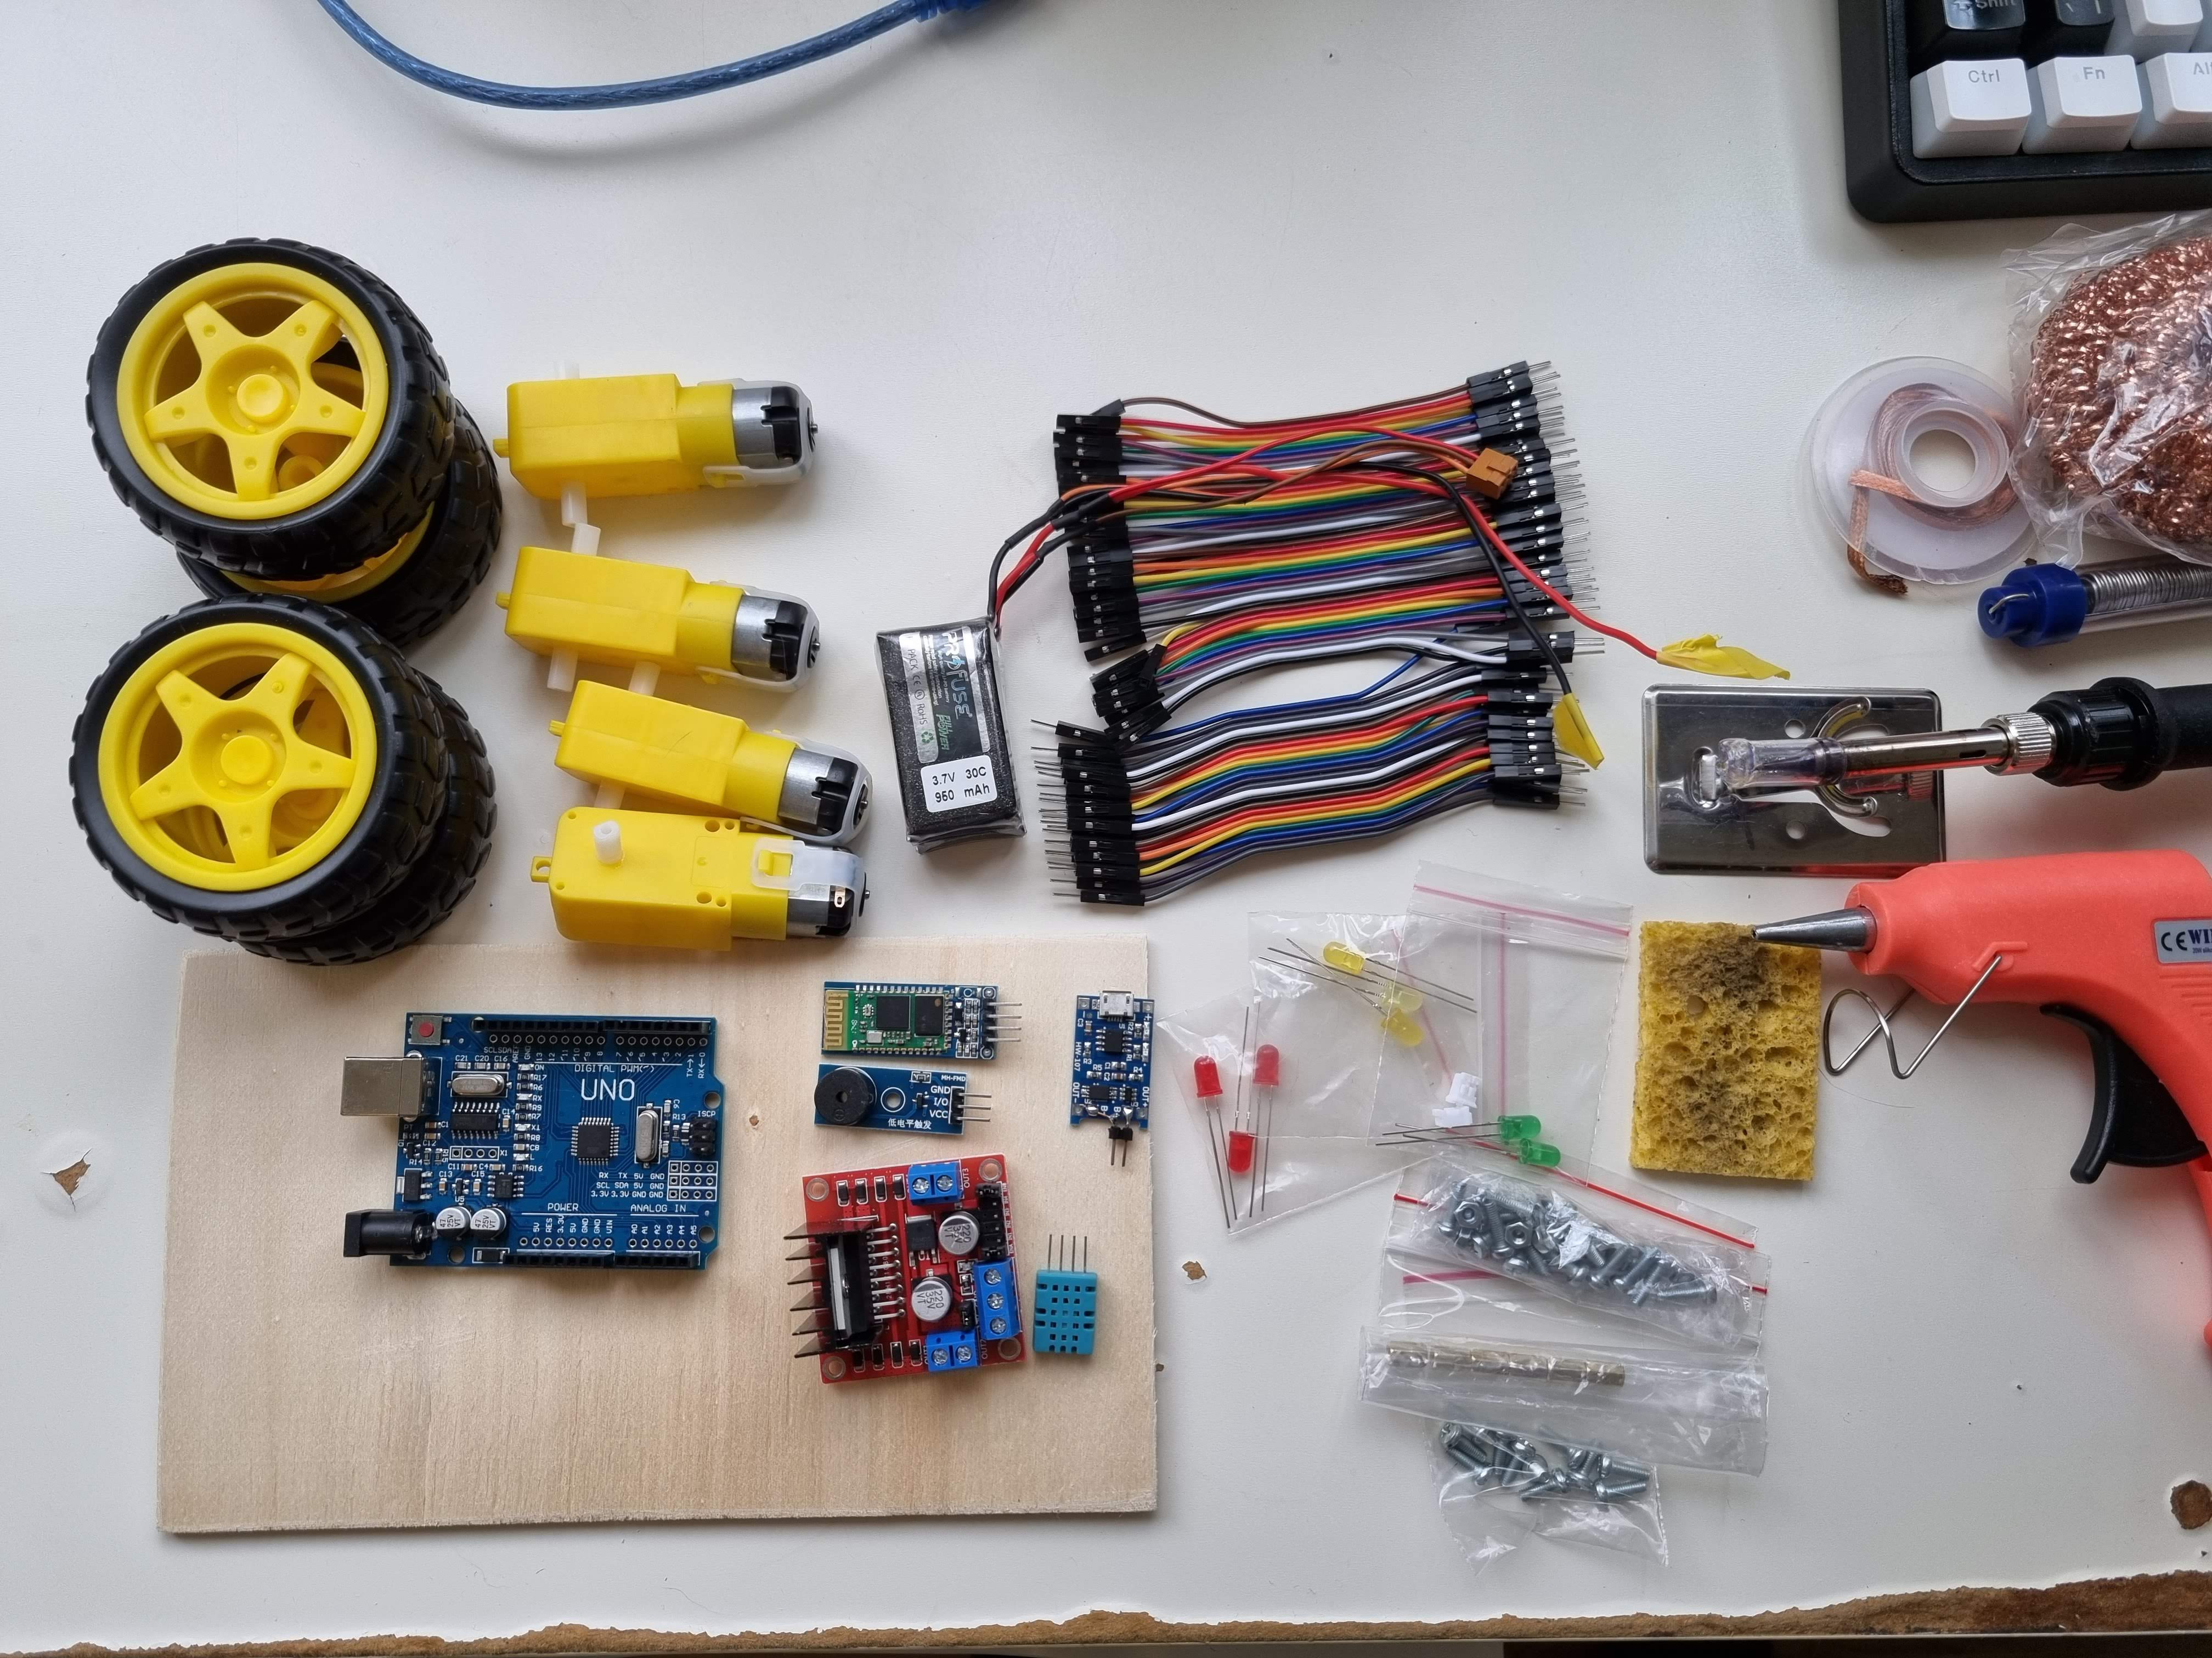
Materials used in the project and their purpose
DC Motor (4x)
Used to rotate the wheels.
Wheel (4x)
Used to move the vehicle.
20x12cm Wooden Board
Used as chassis.
LED (2x Red, 2x Yellow)
Used for illumination and the stress signal.
Arduino Uno
Main controller unit every component.
Connects each part and allows programming.
Buzzer
Used for the horn and stress signal.
Breadboard
We strapped this on after getting tired of soldering.
Li-Po Battery (2x in series)
Used to power the system.
TP4056 Charging Module
Charges the batteries via micro-USB cable.
HC06 Bluetooth Module
Allows Bluetooth connection which is the main method for connecting to the remote.
L298N Controller Module
A controller between each motor and the Arduino. Allows us to program accordingly.
220Ω Resistor (4x)
Required for each LED.
Jumper Cables (Countless)
Connects each component together and also works to make us frustrated during hours of cabling.

Slide 4
Functions of the Robot
Motor control for the wheels for each direction
Forward
Backward
Left
Right
Forward Right
Forward Left
Backward Left
Backward Right
Bluetooth Connection to Android Remote App
Headlights On/Off
Taillights On/Off
Activate Horn
Activate Stress Signal
Charging via Micro-USB Cable

Slide 5
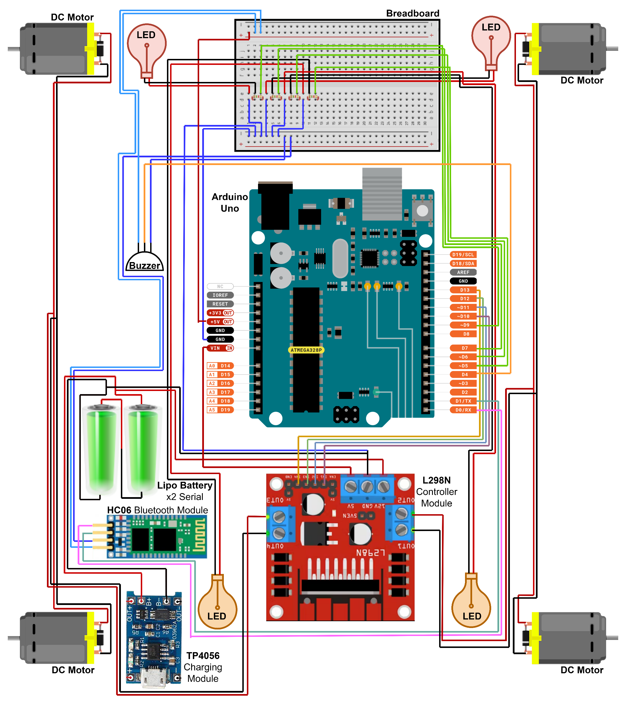
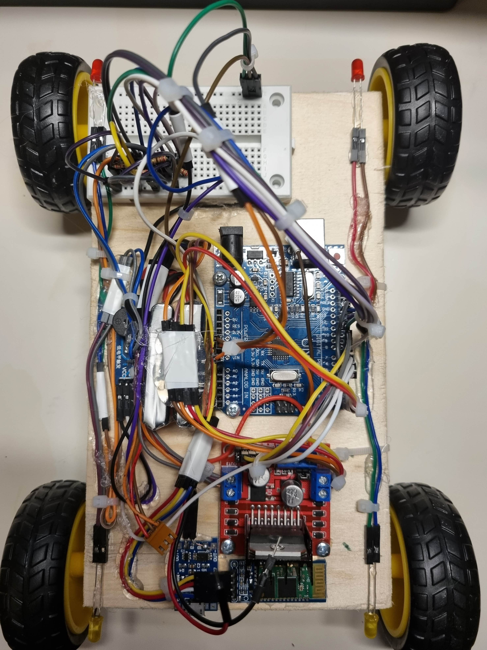
Circuit
Diagram

Slide 6
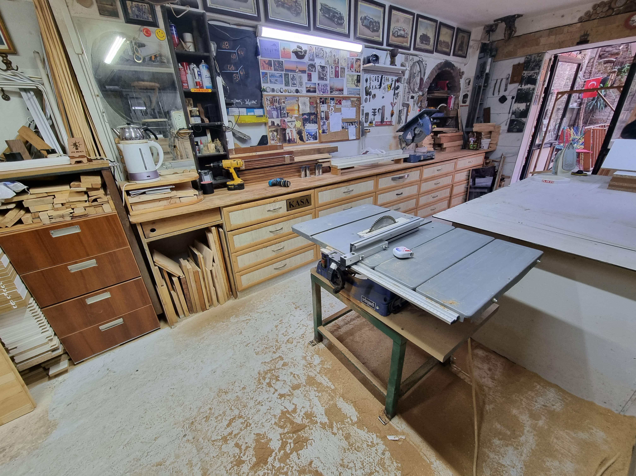
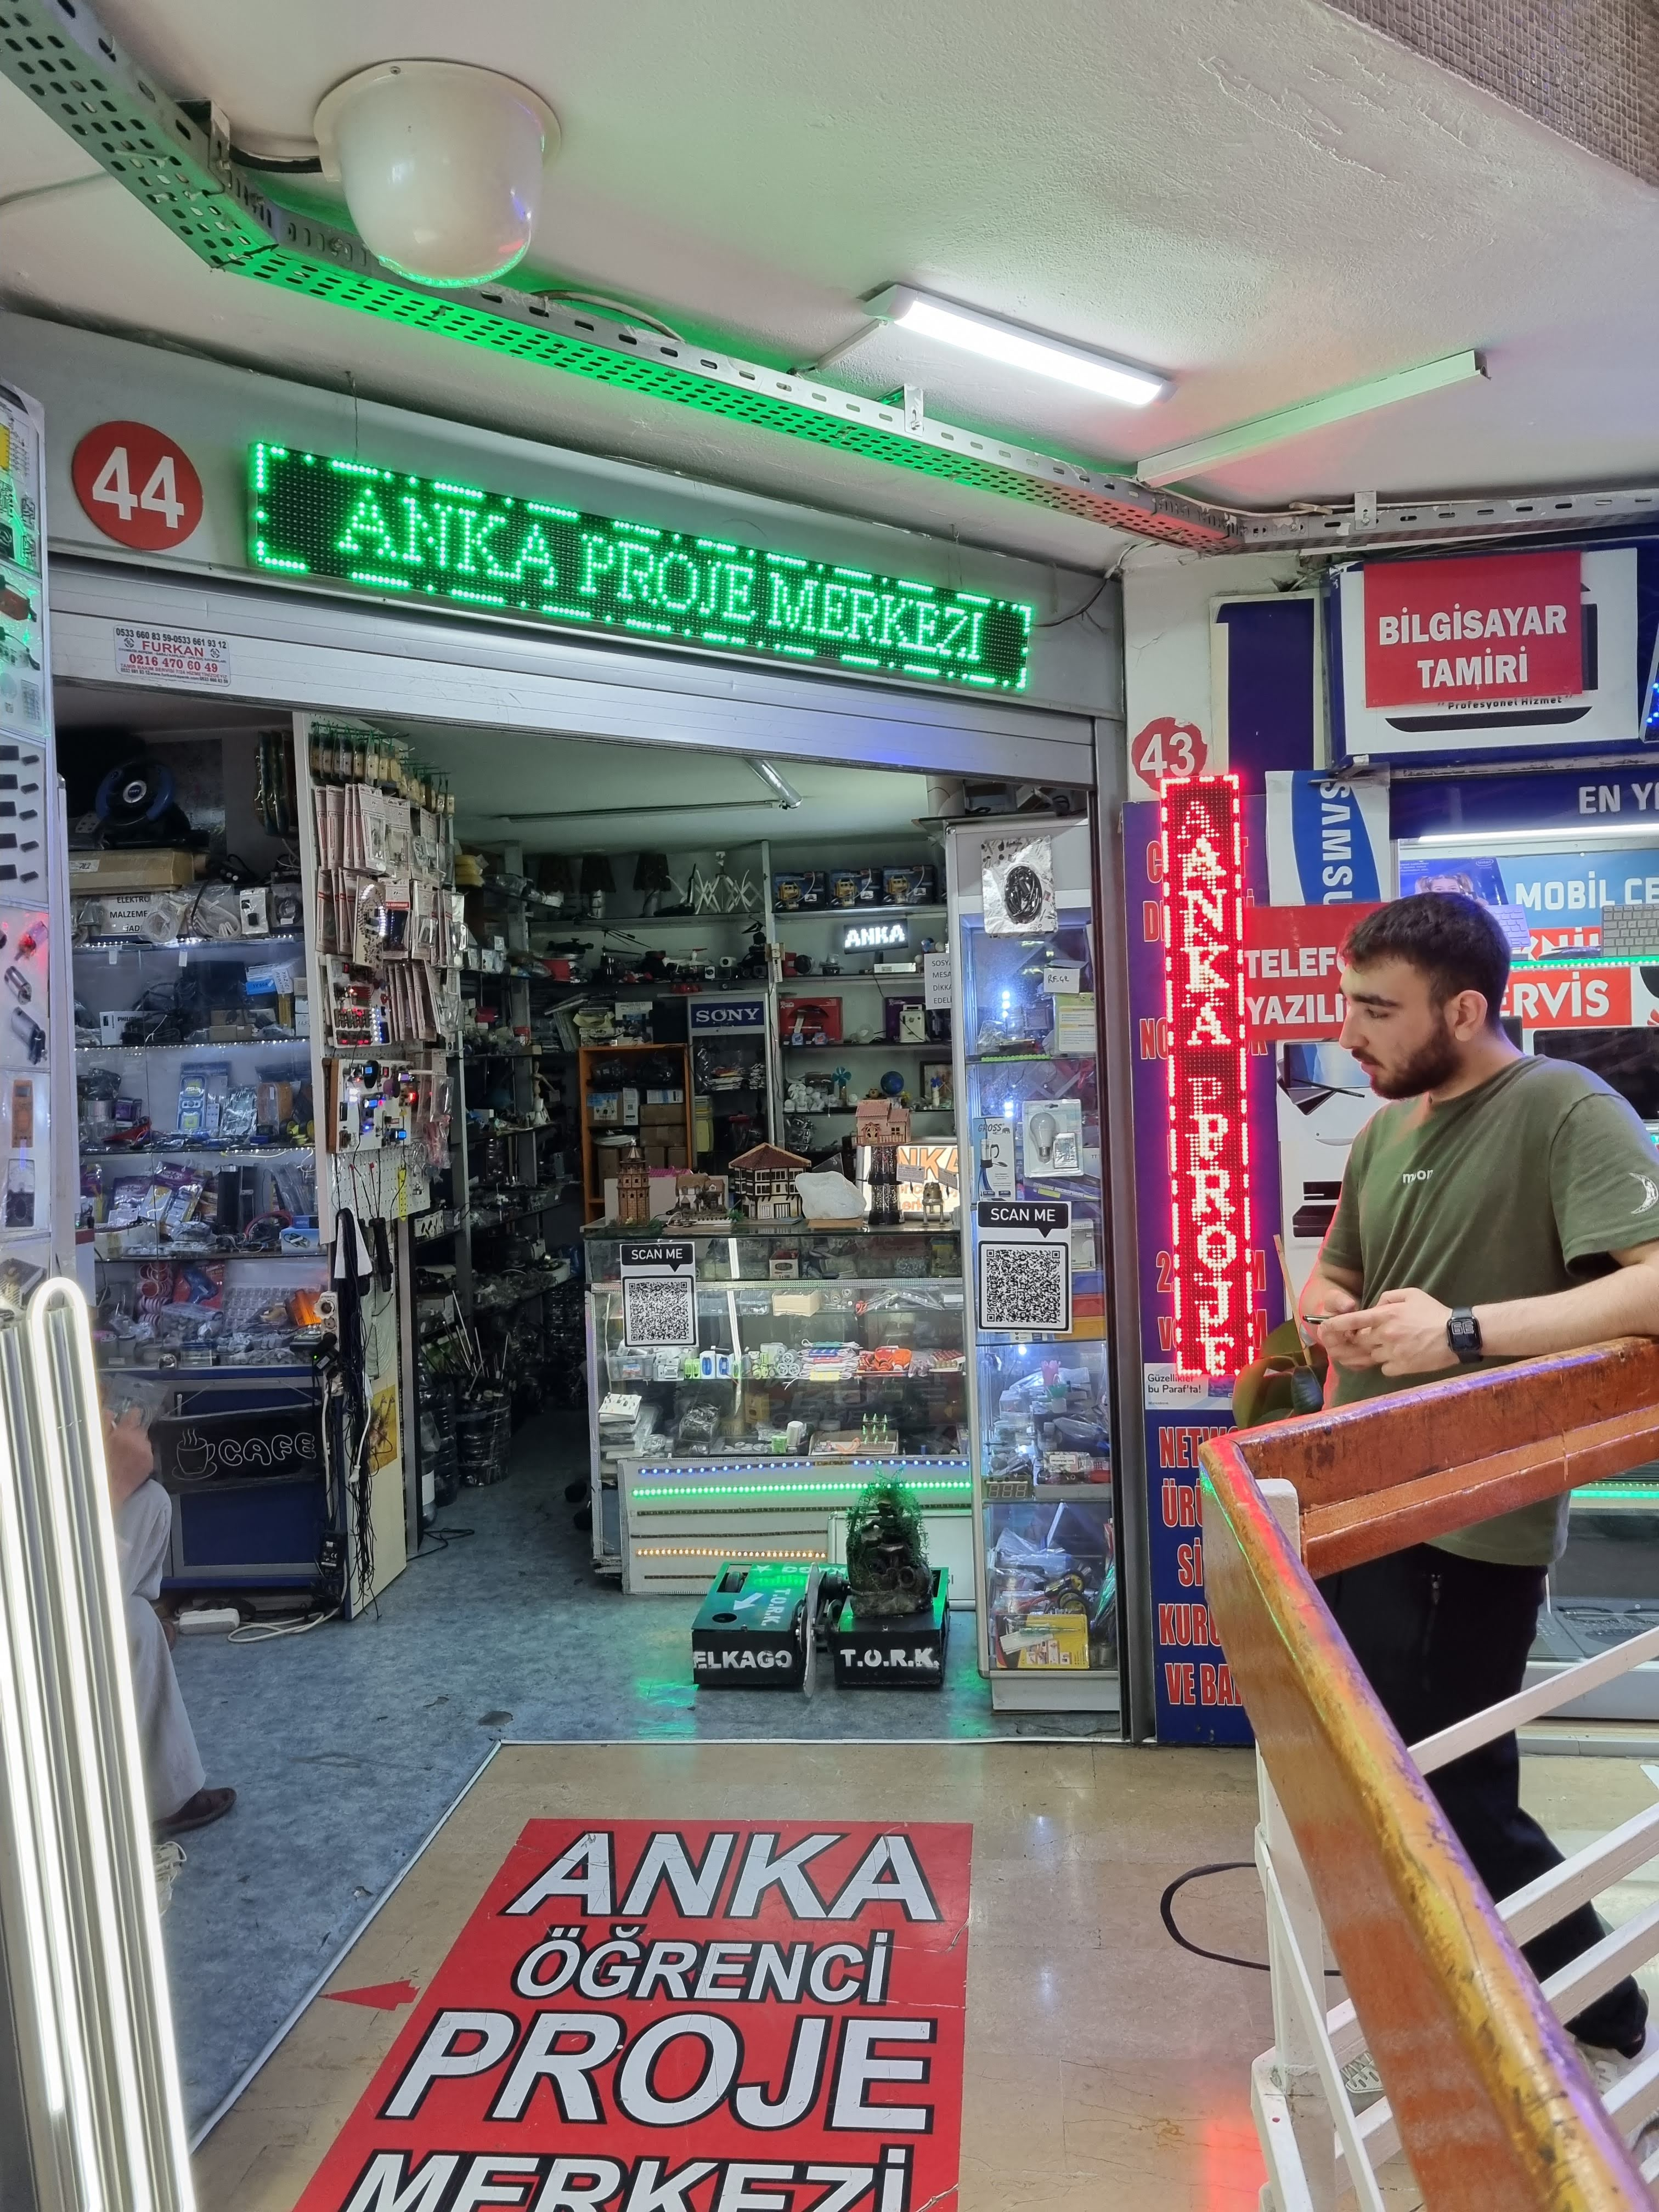
Photos Related to the Project
Found a carpenter for the chassis
Found the perfect store for buying parts and getting recommendations

Slide 7
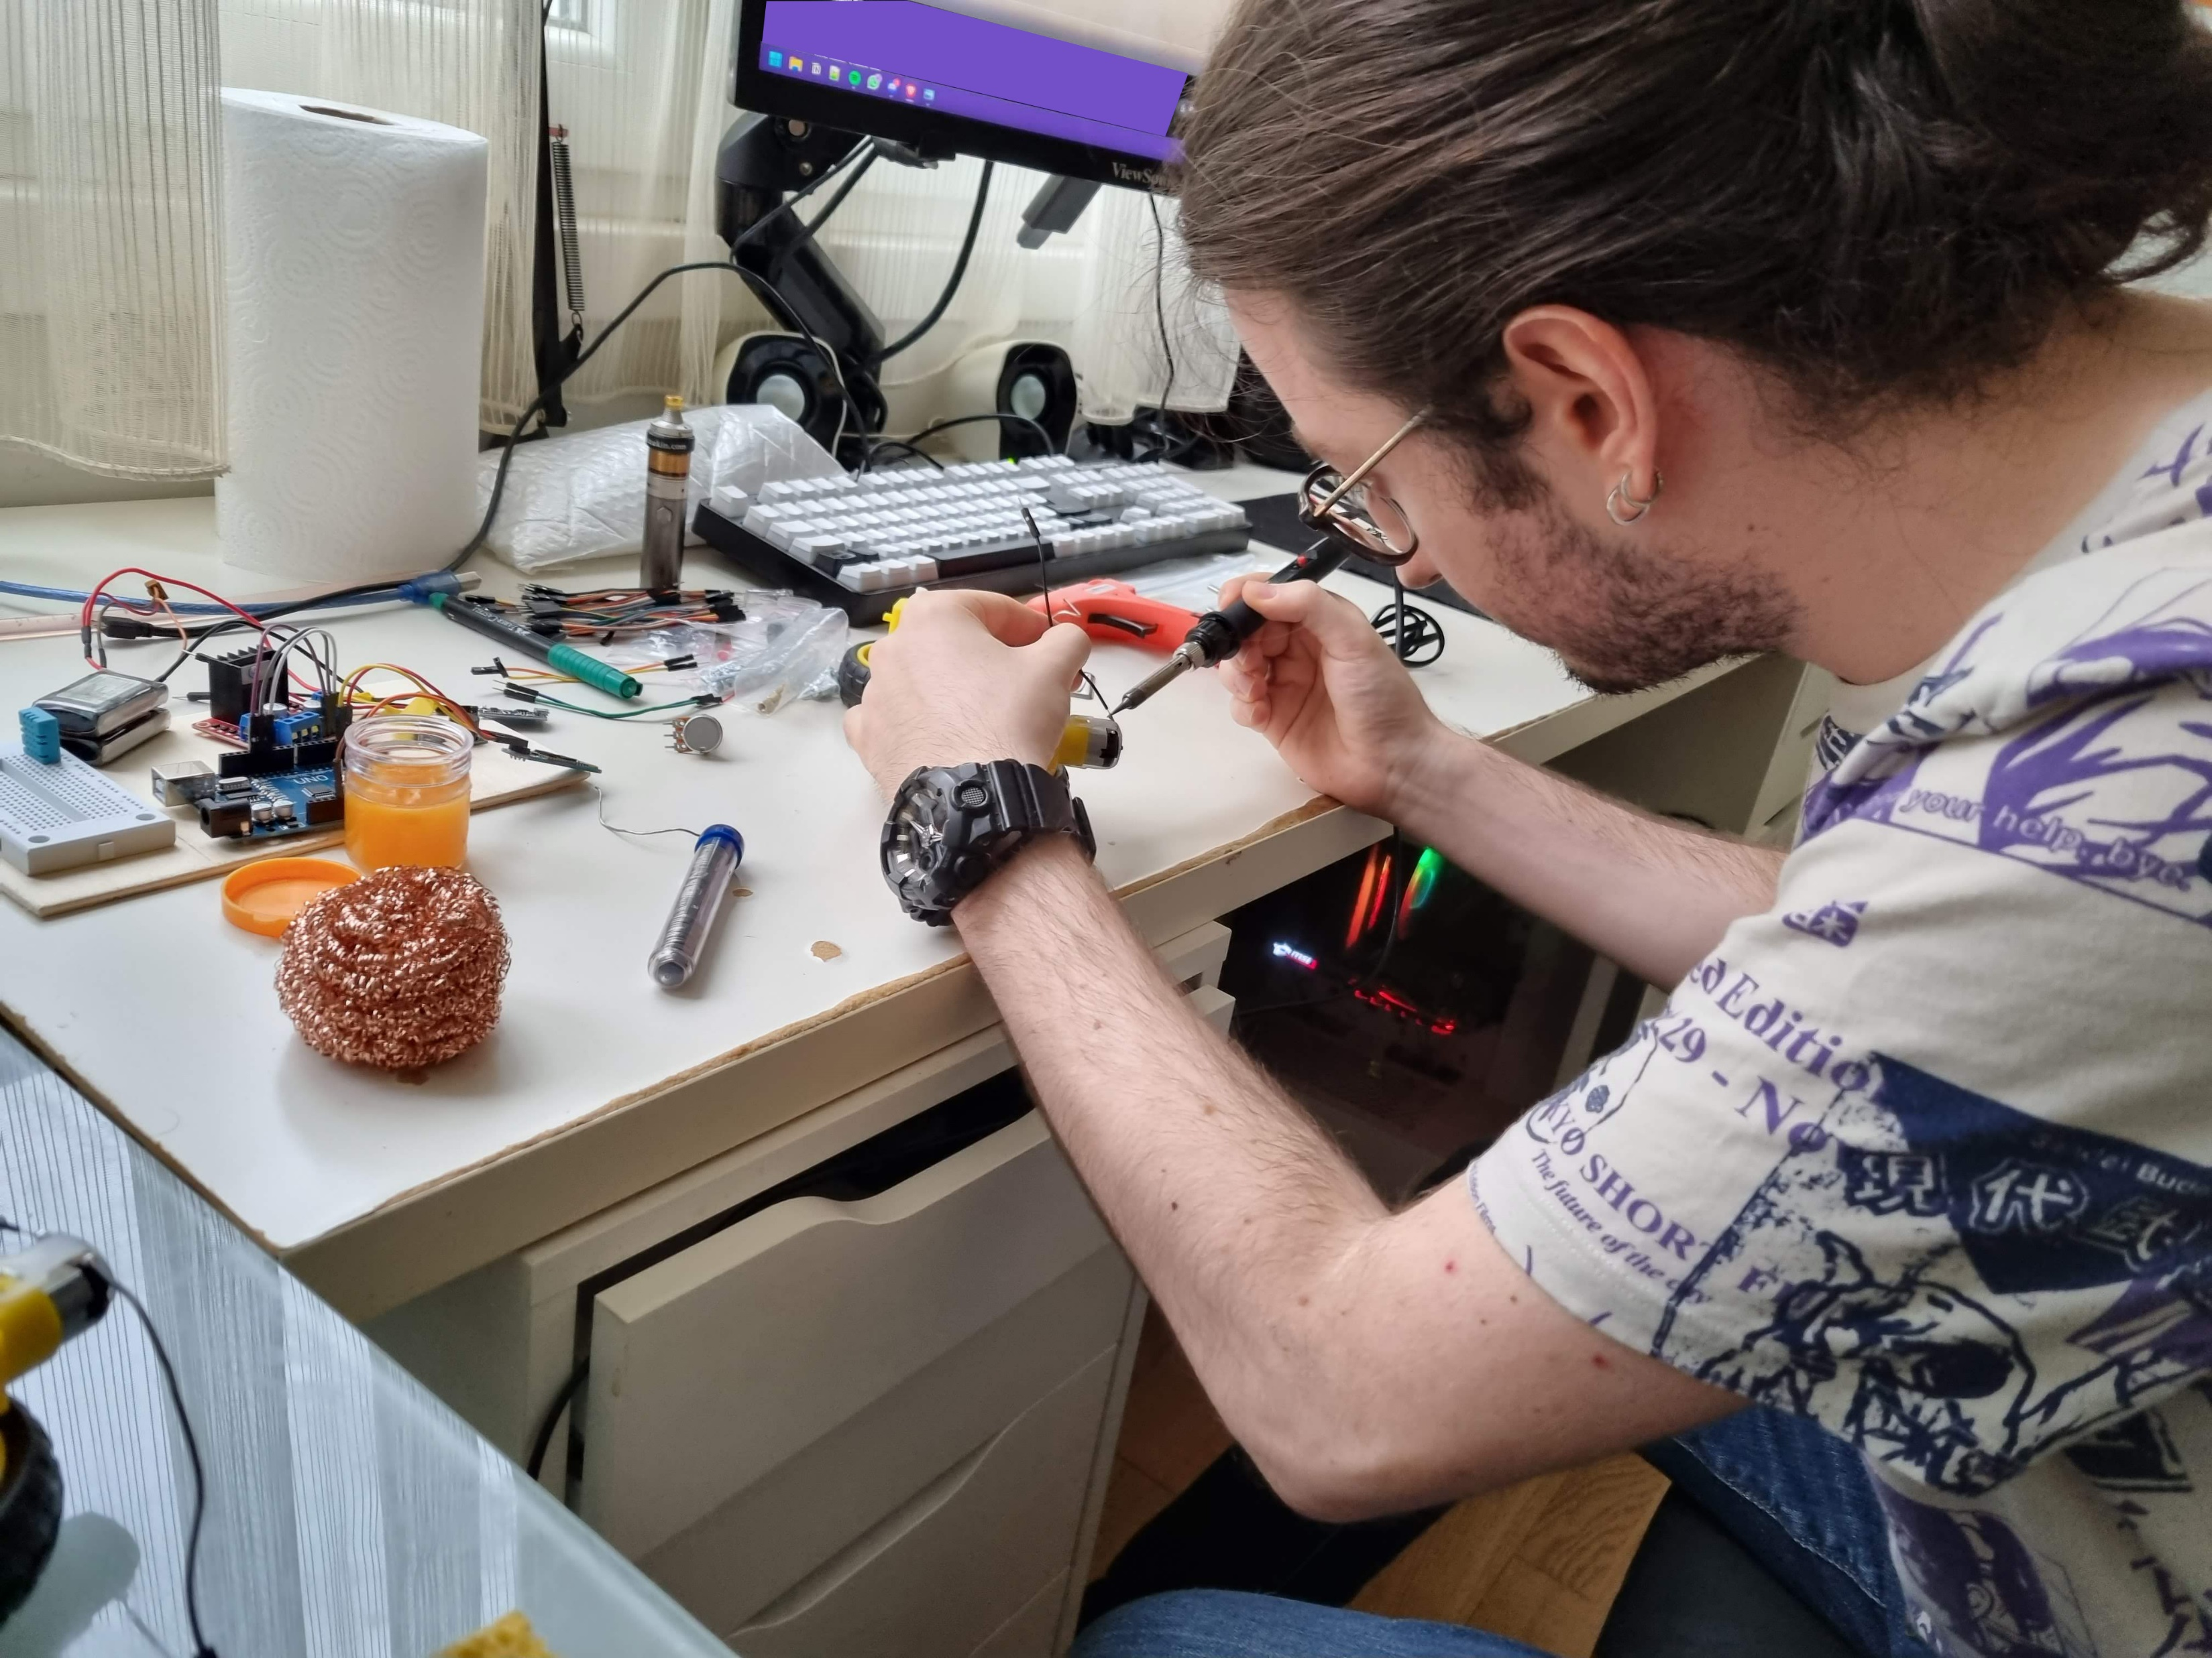
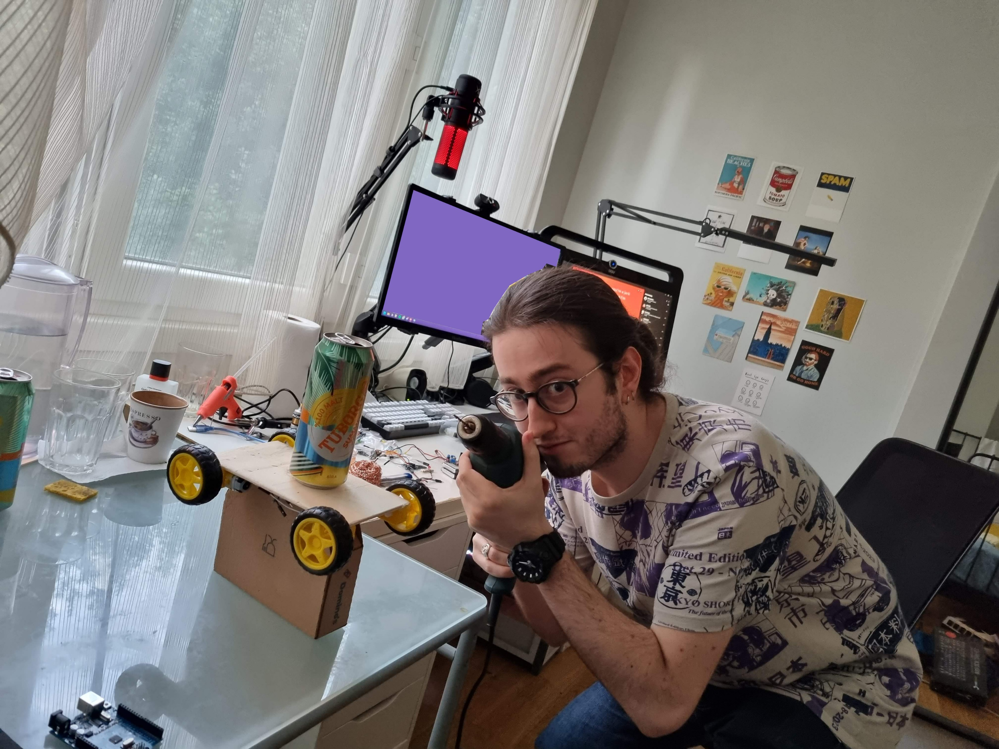
Photos Related to the Project
Soldering for the first time
Using a drill for the first time (unreal)

Slide 8
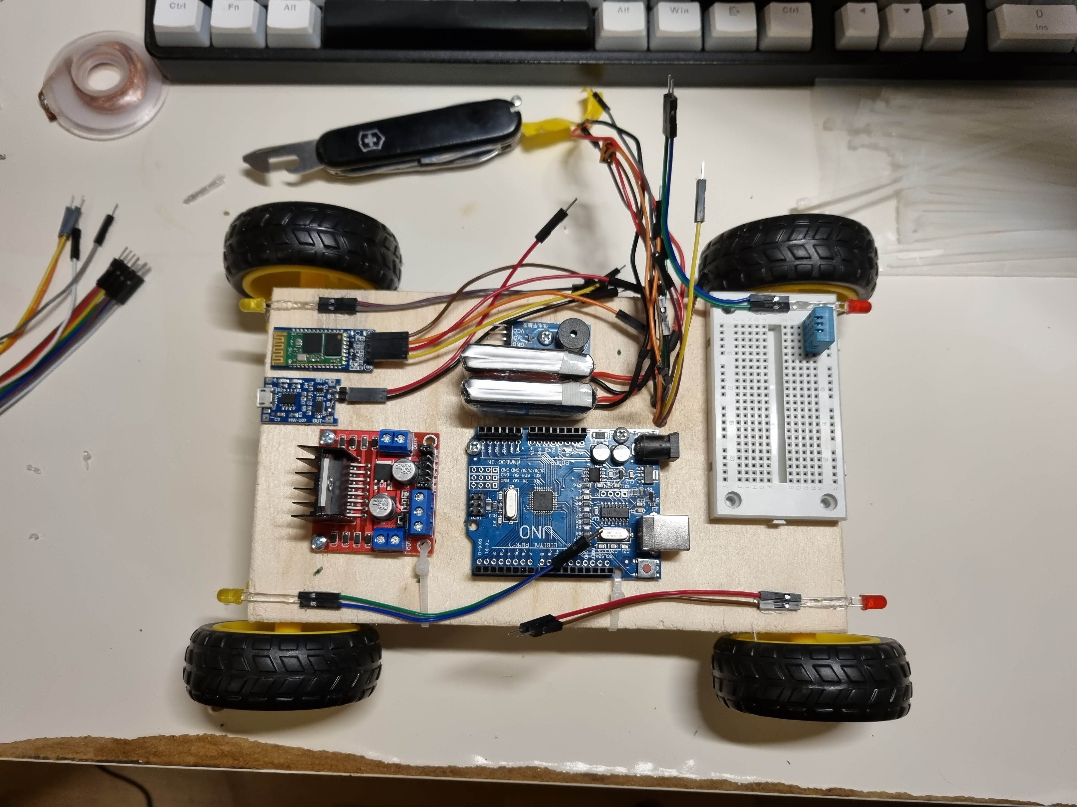
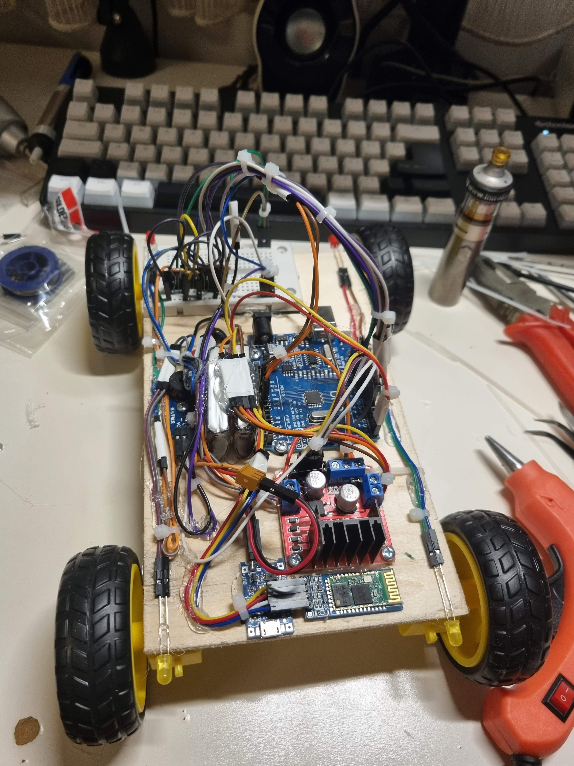
Photos Related to the Project
Before Cabling
After Cabling

Slide 9
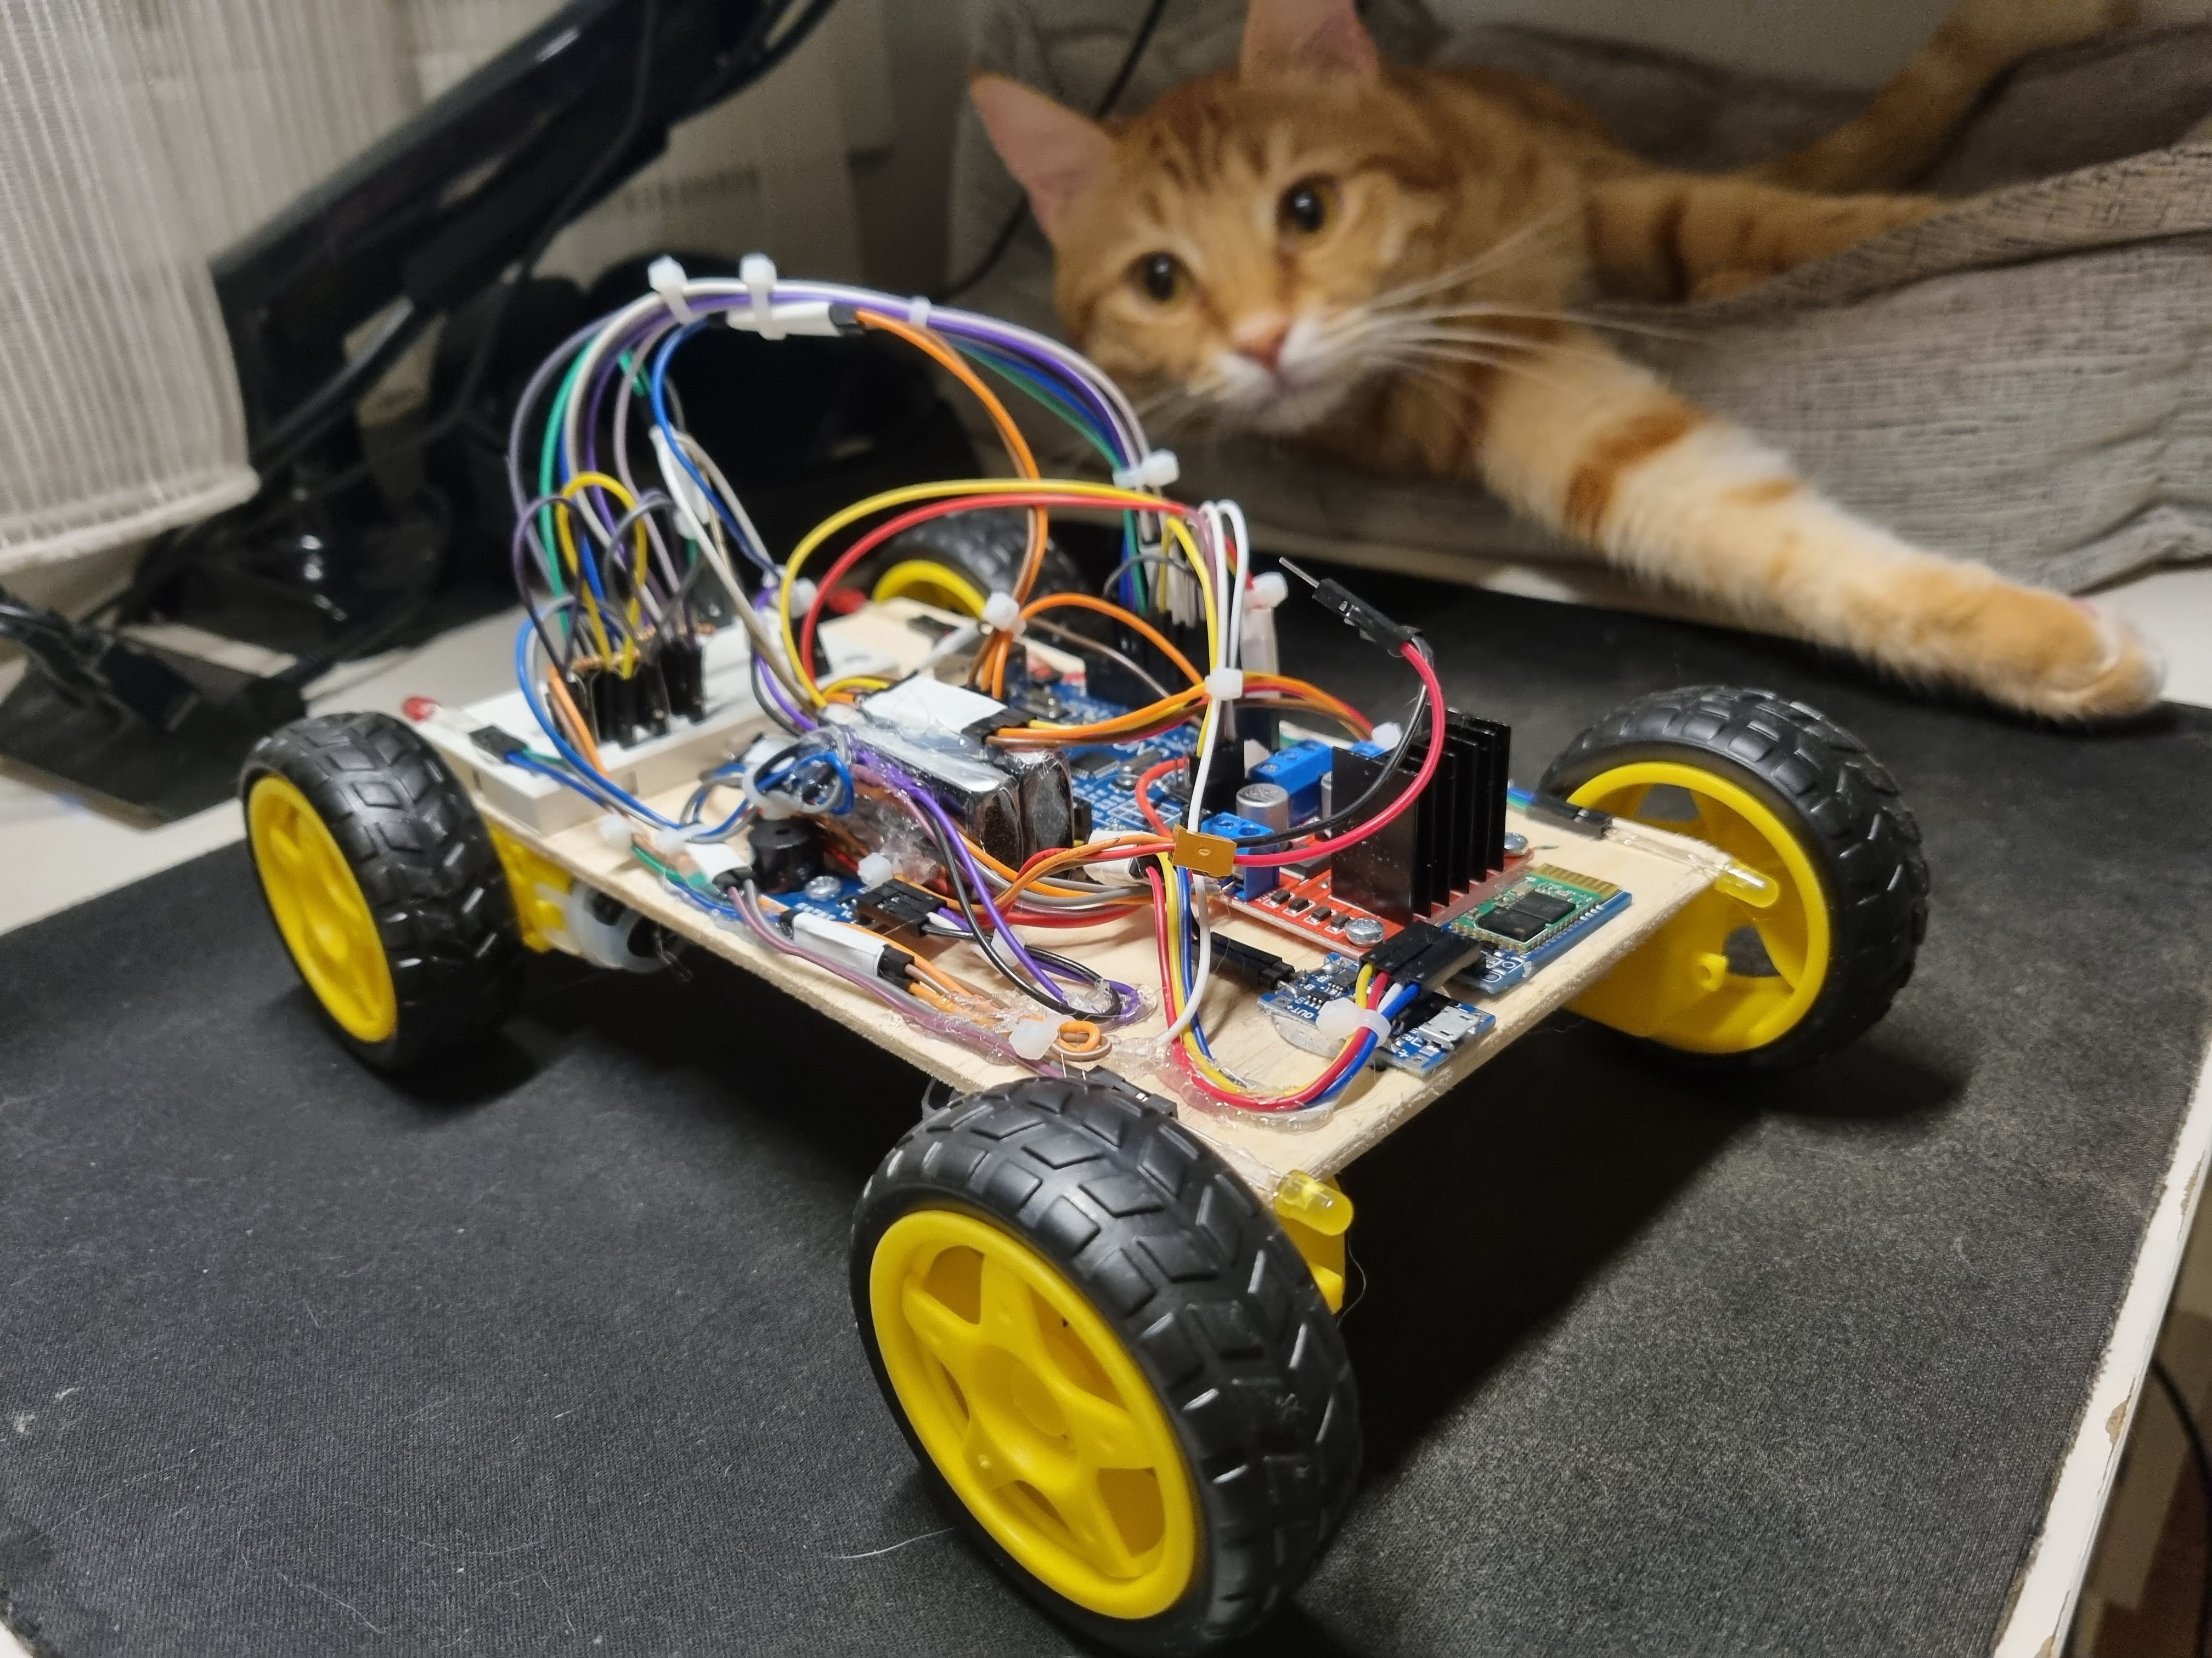
Photos Related
to the Project
End Result

Slide 10
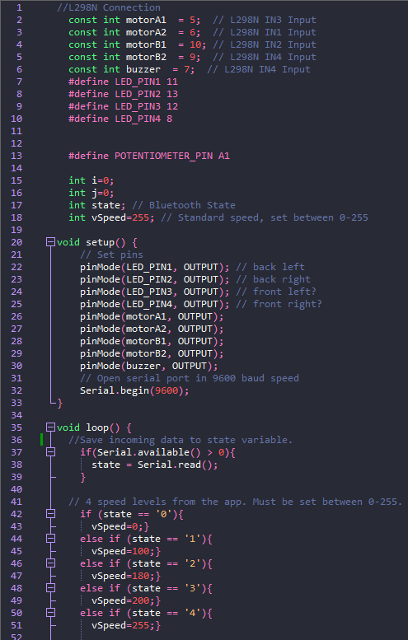
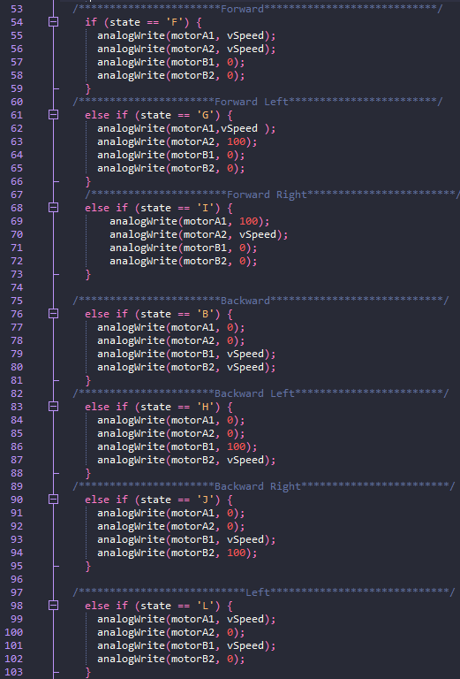
Complete Arduino Code (Full code is available on GitHub: https://github.com/utaysi/Arduino-Bluetooth-RC-Car)

Slide 11
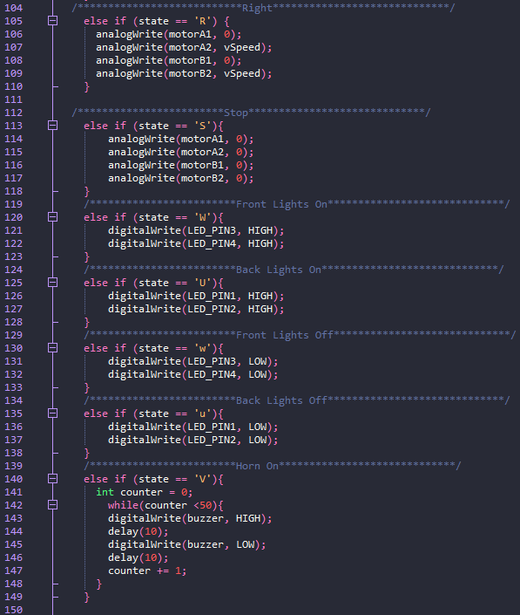
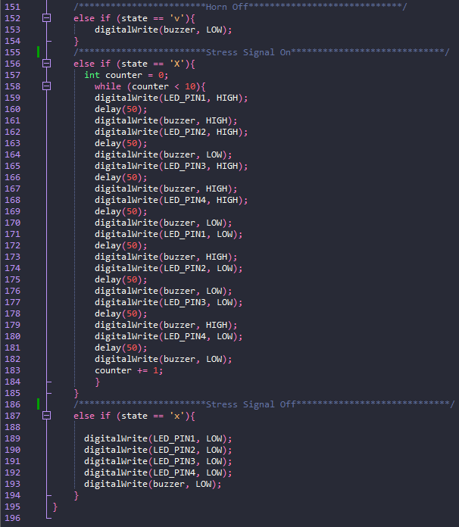
Complete Arduino Code (Full code is available on GitHub: https://github.com/utaysi/Arduino-Bluetooth-RC-Car)

Slide 12
Thanks for listening.

